Slide 1
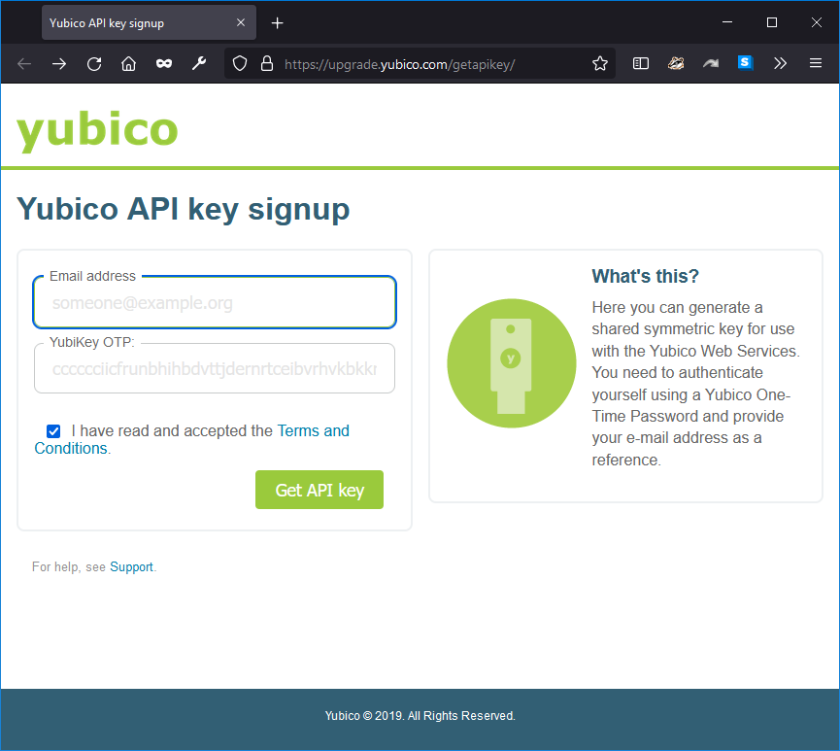
https://upgrade.yubico.com/getapikey/

Slide 2
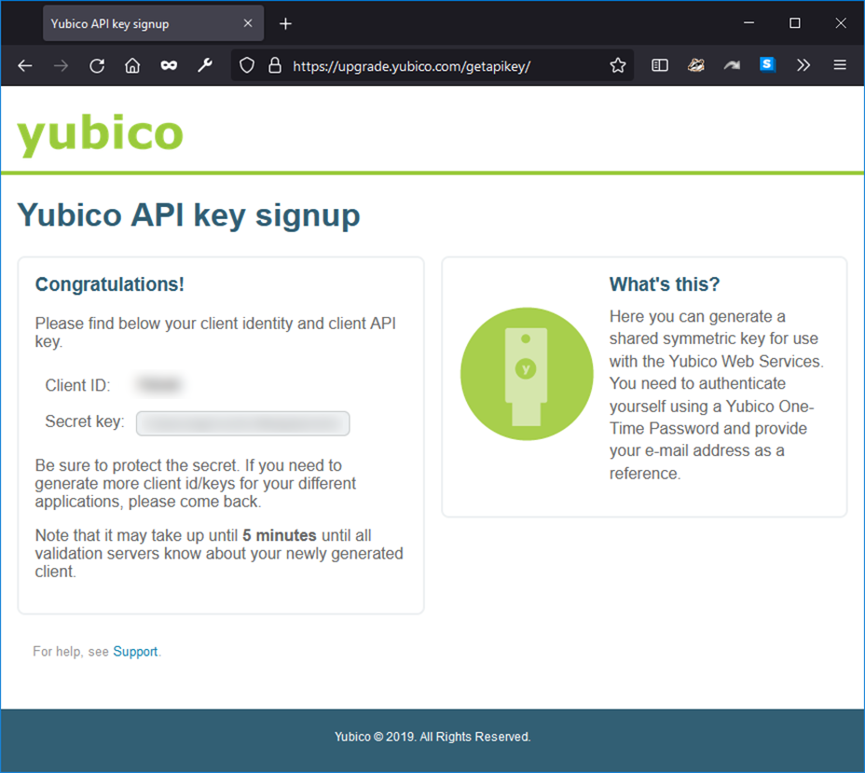

Slide 3
Config.json
{
"domains": {
"": {
"yubikey": {
"id": "11111",
"secret": "xxxxxxxxxxxxxxxxxxxxxxxxxxxxx"
}
}
}

